Slide 1
OUTER SPACE
By Tasnim & Misha

Slide 2
WHOA!
There are an estimated more trees on Earth than stars in the Milky Way Galaxy!

Slide 3
— Carl Sagan
“Who are we? We find that we live on an insignificant planet of a humdrum star lost in a galaxy tucked away in some forgotten corner of a universe in which there are far more galaxies than people.

Slide 4
TABLE OF CONTENTS
01
Our UNIVERSE
02
Search for Life
03
NASA & ISS
04
Theories of Space
Our home is full of star nurseries, black holes, and more!
Both intelligent and bacterial life beyond us… exists?
These 2 organizations and places collaborate globally.
Humans don’t know lots of the universe, let alone the multiverse….

Slide 5
01
Our UNIVERSE
Yes, this section is mostly focused on our solar system. But there’s much more to just our little town in space.

Slide 6
Our Solar System
MERCURY
VENUS
It’s the closest planet to the Sun and the smallest one in the Solar System.
It’s the second and hottest planet from the Sun, and its atmosphere is extremely poisonous.

Slide 7
Our Solar System
EARTH
JUPITER
NEPTUNE
The only reason we survive is because of the Goldilocks Zone.
This gigantic gas giant has a storm that has been occurring for centuries, and is twice as big as the Earth, called the Giant Red Spot.
Neptune, an ice giant, has winds that are faster than the speed of sound on Earth., and it’s year is 164.81 Earth years.

Slide 8
Our Solar System
Saturn
Uranus
Pluto
Saturn is most known for its visible rings!
An ice giant, Uranus has a weird tilt; it’s almost on its side!
This dwarf planet was argued to be a planet for years.

Slide 9
OUR EARTH
Mt. Everest
Fjords
Earth's highest mountain.
Norway’s fjords provide a breath - taking view.
The Great Barrier Reef
The Nile
Earth’s longest river (4,132 mi).
Earth’s largest coral reef is bursting with life of all kinds..

Slide 10
OUR PLANET’S LAYERS
The Crust
The Outer Core
The Mantle
The Inner Core
The surface is where we live.
It’s made of liquid iron/nickel.
No one has reached this layer made of minerals and magma.
1,200 km. and 5,200 degrees C, this is interesting!

Slide 11
What are Nebulas?
According to nasa.gov,” Nebulae are enormous clouds of dust and gas occupying the space between the stars.”. Basically, these are star nurseries. The Hubble Site gives a good explanation on how stars are formed. “These knots [part of the nebula] contain sufficient mass that the gas and dust can begin to collapse from gravitational attraction. As it collapses, pressure from gravity causes the material at the center to heat up, creating a protostar. One day, this core becomes hot enough to ignite fusion and a star is born.”. Basically, gravity makes dust and other stuff fly around super fast until there’s so much tension and heat to create fusion (the merging or division of an atom) which leads to a star being born. “Some nebulae (more than one nebula) come from the gas and dust thrown out by the explosion of a dying star, such as a supernova. Other nebulae are regions where new stars are beginning to form.”.
We don’t know much about nebulas and stuff, but it’s a true wonder of the world. Without these nebulae, stars would become extinct. Stars that still exist would slowly die, leaving no more stars to generate heat, safety, gravity, energy, light, and more, which means that life forms would cease to exist.
Nebulas are beautiful sights. There’s tons of colors and misty dust. Some nebulae look like certain shapes, like the Crab Nebula, Spider Nebula, and the Pillars of Creation. Fun fact: the Pillars of Creation don’t exist anymore and we’re seeing light emitted 6,500-7,000 light years away (years ago).

Slide 12
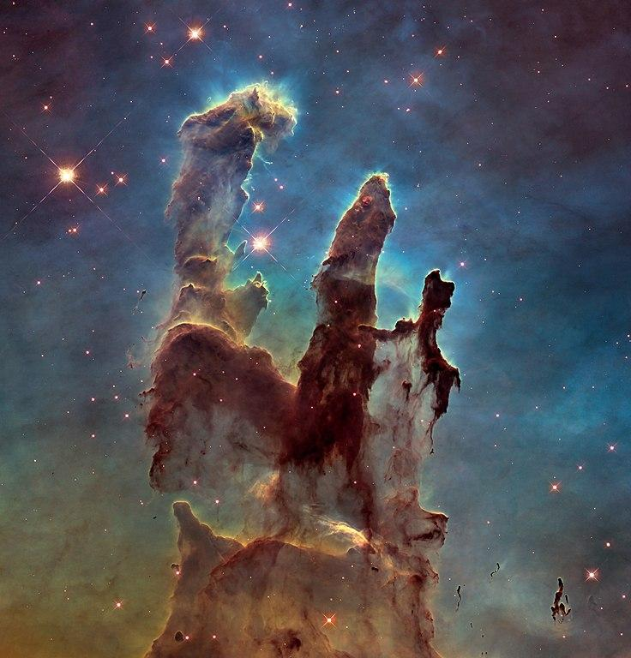
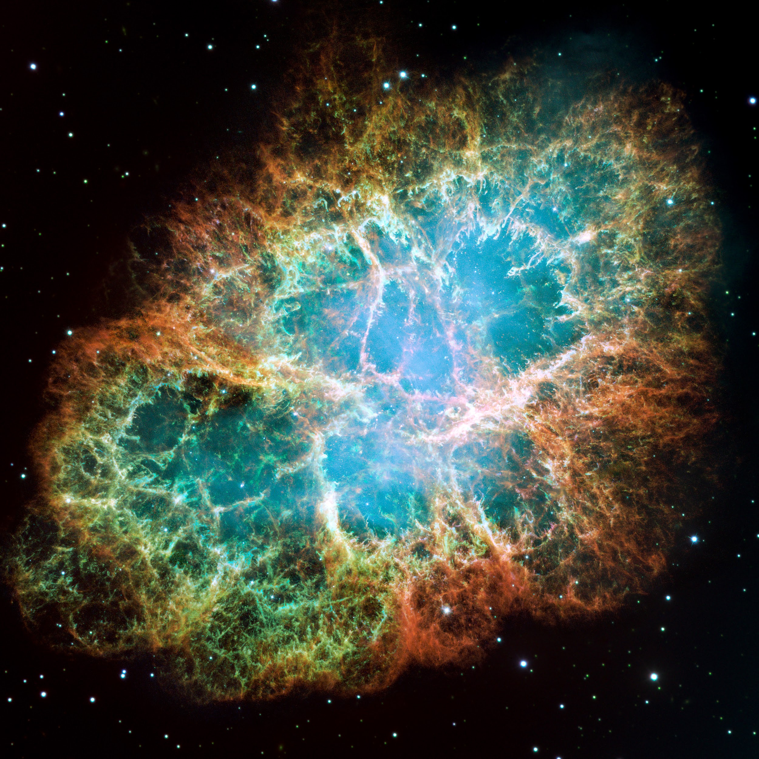
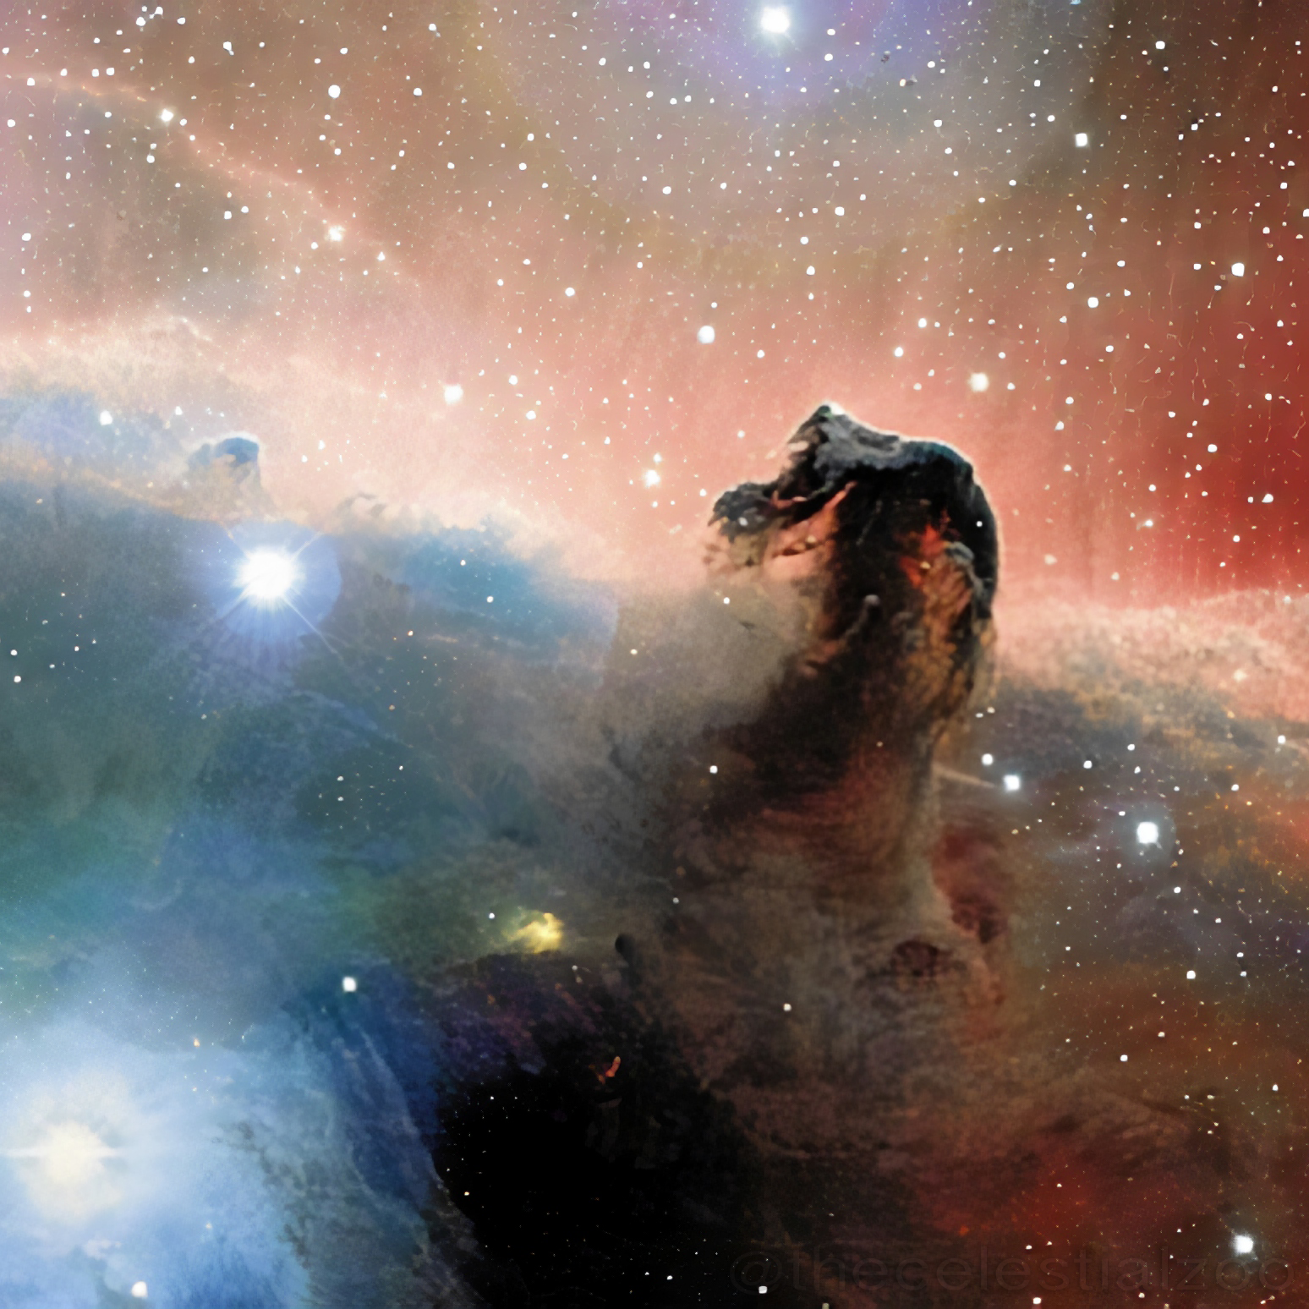
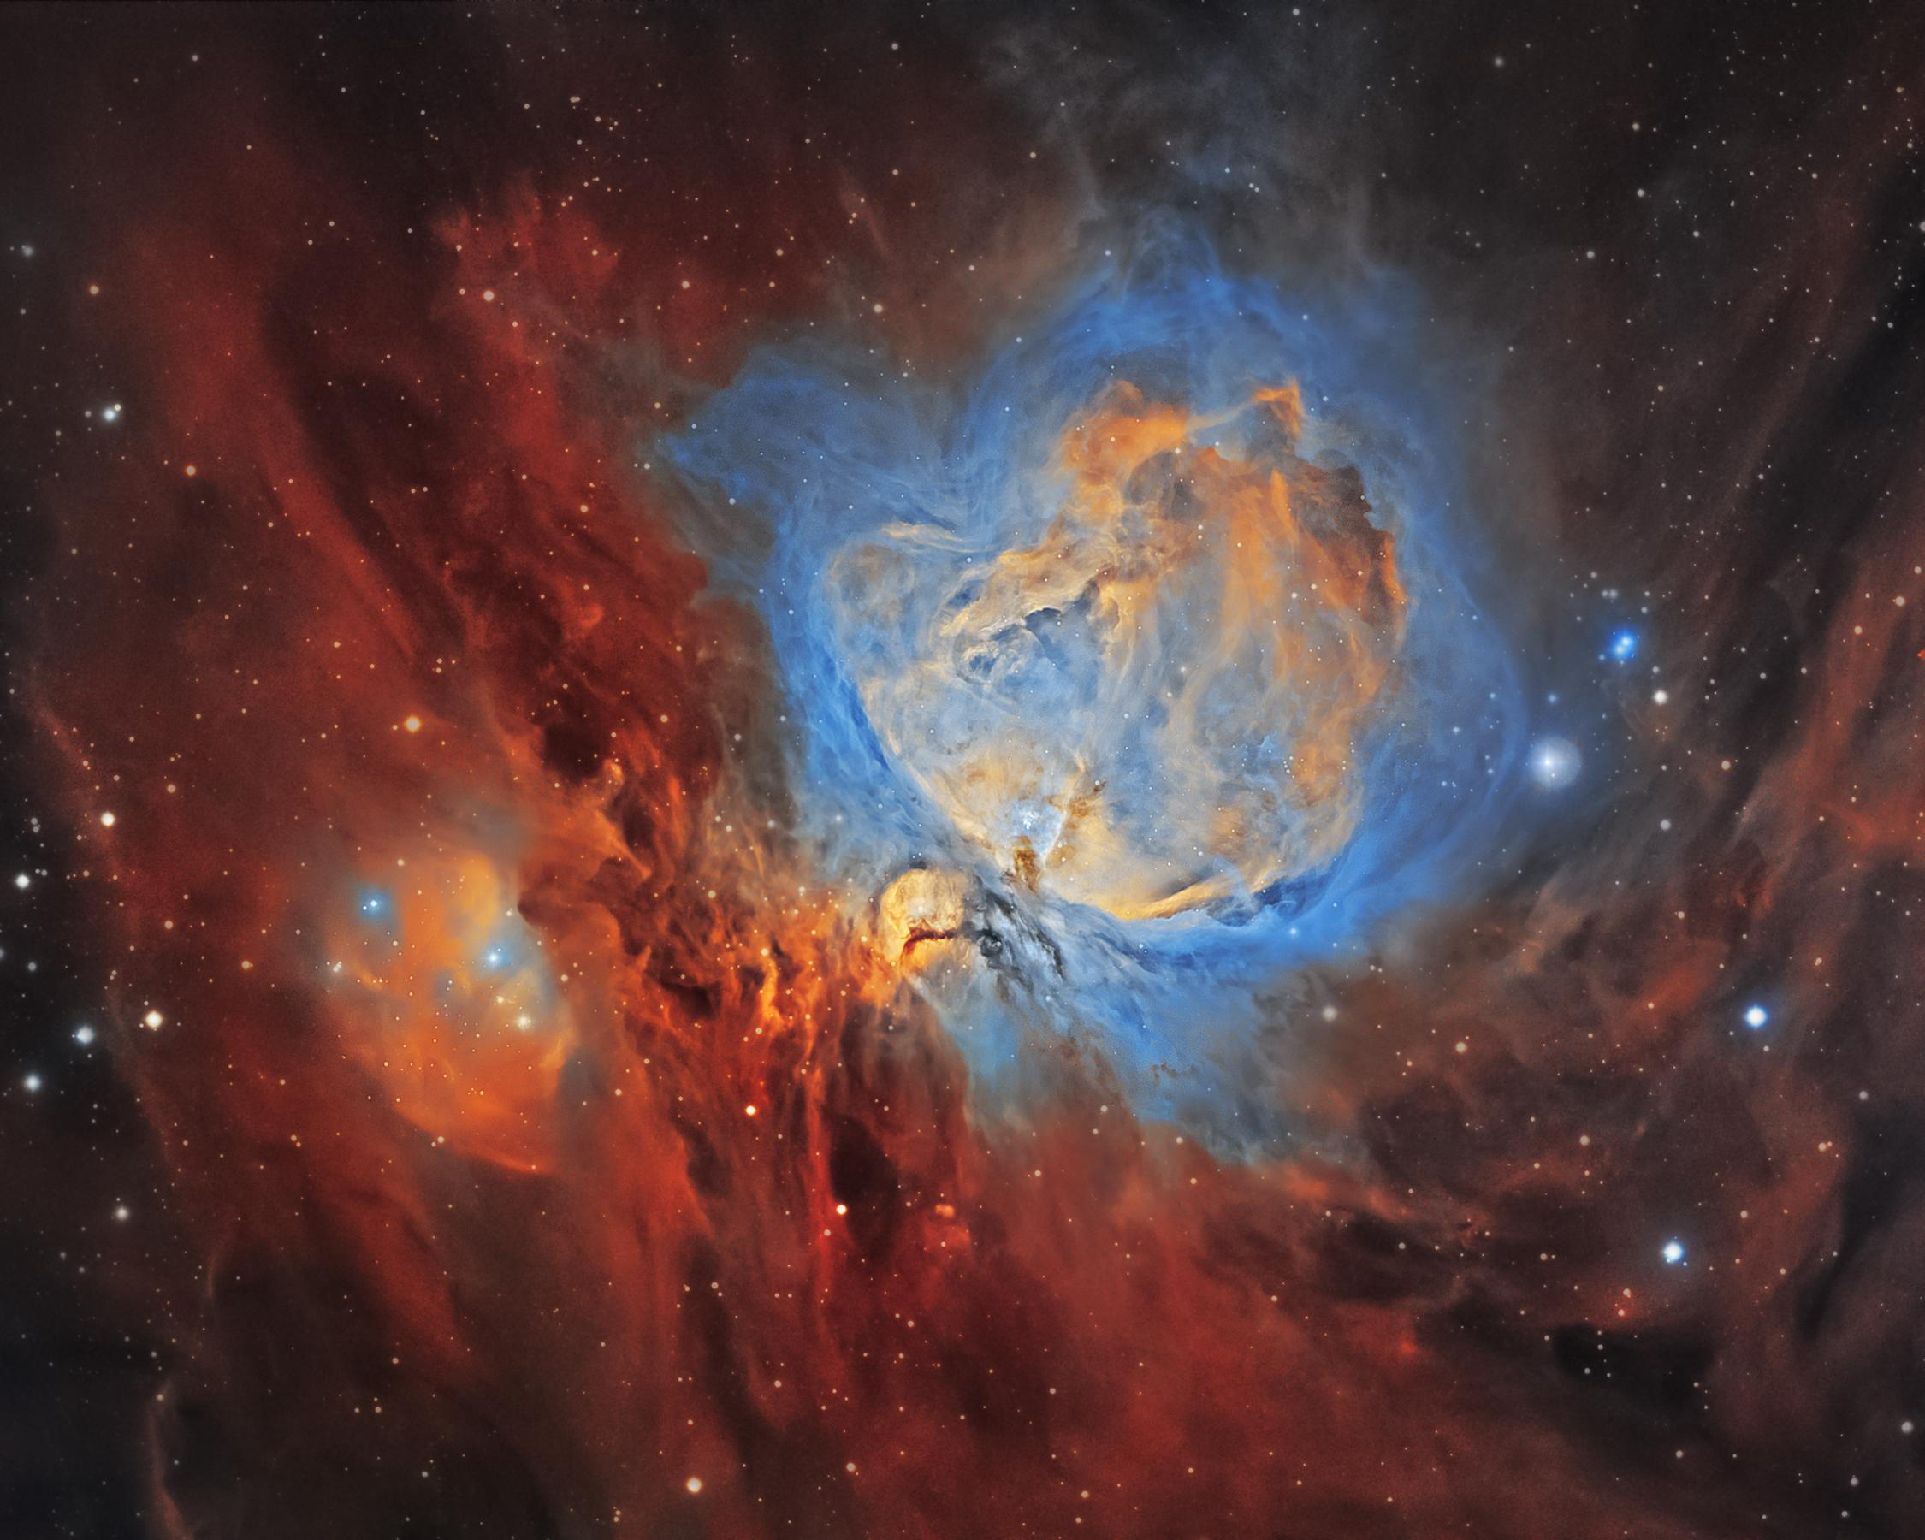
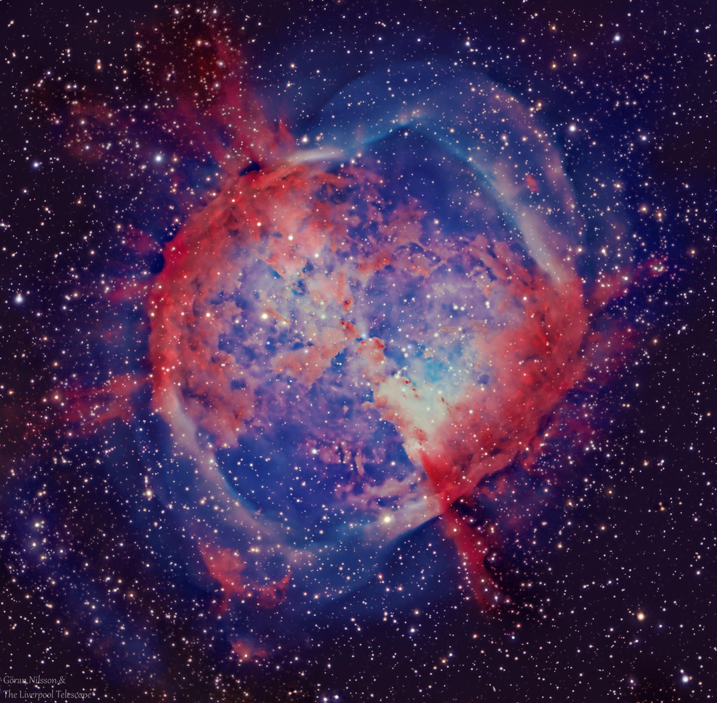
Clockwise from top left: Pillars of Creation(part of Eagle Nebula), Crab Nebula, Horsehead Nebula, Orion Nebula, Dumbbell Nebula

Slide 13
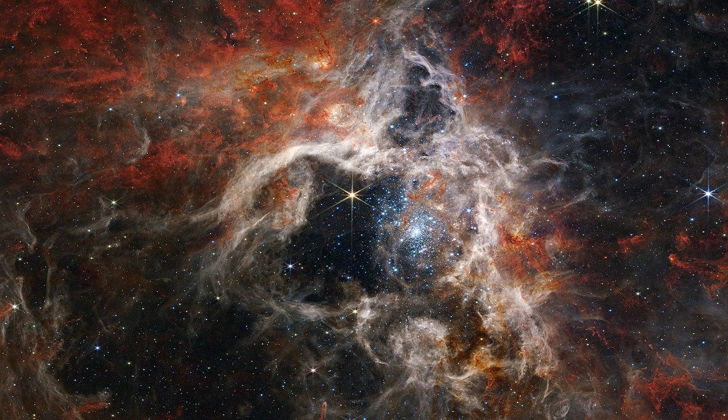
The Tarantula Nebula is the biggest known nebula at 931 light years across.

Slide 14
Voids in Space
Voids are areas in space…and, you know what? Nasa gives a much better definition. “By definition, an astronomical void is a space with few to no galaxies in it. These voids, along with superclusters (a mosh pit of galaxy clusters) are thought to be the largest things in the Universe.”. So, a void is an area of space where there isn’t much matter in it, or galaxies. Yes, most voids do have some galaxies, though.
Voids are often measured in megaparsecs,”a measurement equal to one million parsecs or 3.26 million light years”. That’s how big megaparsecs are. One megaparsec is 3.26 million light years, or it would take you 3.26 years at the speed of light to complete the distance of one megaparsec.

Slide 15
The Bootes Void
The Bootes Void is a region in space where the Bootes constellation lies. There are hardly any galaxies in this area, so it’s called a void. APPARENTLY, get ready, are you ready, cuz’ you need to be ready, the Bootes Void’s radius is
………………………………………………….
62 MEGAPARSECS (202 million, 120 thousand lightyears)

Slide 16
02
Search for Life
There’s one question that has been nagging scientists for centuries: is there life beyond us?

Slide 17
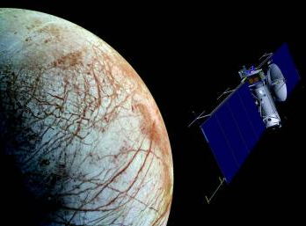
THE SEARCH FOR LIFE
There is life beyond us. Just one question. Where?

Slide 18
Is There Life Beyond Us?
According to NASA,”The search for life beyond Earth is really just getting started, but science has an encouraging early answer: there are plenty of planets in the galaxy, many with similarities to our own. But what we don’t know fills volumes.”
Basically, yes, it is almost confirmed that there is life beyond us. The universe is HUGE, and there may even be a multiverse (more on that later).

Slide 19
HOW IN THE UNIVERSE WILL WE FIND LIFE?
We don't really have a universally accepted definition of life itself. That said, we might not need one. We need only detect the telltale signs of life in an exoplanet (a planet outside our solar system) atmosphere , and we have a better understanding of what those look like here on Earth.
As reported by NASA,”The James Webb Space Telescope , launched in 2021, could get the first glimpses: the mix of gasses in the atmospheres of Earth-sized exoplanets. Webb, or a similar spacecraft in the future, could pick up signs of an atmosphere like our own - oxygen, carbon dioxide, methane. A strong indication of possible life. Future telescopes might even pick up signs of photosynthesis – the transformation of light into chemical energy by plants – or even gasses or molecules suggesting the presence of animal life. Intelligent, technological life might create atmospheric pollution, as it does on our planet, also detectable from afar. Of course, the best we might be able to manage is an estimate of probability. Still, an exoplanet with, say, a 95 percent probability of life would be a game changer of historic proportions.”.

Slide 20
HOW WILL WE FIND LIFE?
When we go to exoplanets, the light spread into rainbows will provide a better understanding of what it’s like on the planet. Rainbows have different colors because of the elements in our Earth. And, rainbows is just light split into a spectrum. Colors represent chemicals and gases. So, if we can see rainbows on exoplanets, it’ll show what kinds of elements, chemicals, and gases are in the atmosphere, in turn showing if it can support life or not.
One of the best tools scientists have for narrowing the search for habitable worlds is a concept known as “habitable zone “, or the Goldilocks zone. The definition of the habitable zone is the distance from a star at which liquid water could exist around orbiting planets’ surfaces. It’s not to cold, not to hot. Of course, it really depends on the star. Most planets around the size of the Earth orbits around red-dwarfs, and it’s most likely that habitable planets are rocky, not gaseous or icy. Water is CRUCIAL for life, and as far as we know, nothing can survive without liquid water.
Even though, organisms can live in some different conditions then the ones here on Earth. Extremophiles are life forms that love extreme environments, thriving in conditions that would kill anything else.
Notes:
hi

Slide 21
THE SEARCH FOR LIFE
Richard C. Hoagland, a conspiracy theorist and a novelist said that there may have been aliens once on Mars. Waterways seem to have carved out sand, and that supported the hypothesis that aliens once lived on Mars and had to abandon it. Recent findings of a somewhat doorway carved in rock sparked many conspiracy theories. Right now, Mars is very dry, making it seem like a hostile planet since liquid water is supposedly vital for life, but scientists have proof that it may have once had a thicker atmosphere which was able to trap moisture and Sun heat, which means it would have supported life 4 billion years ago.
Biology is the study of living organisms, and biologists have discovered a type of living organisms called extremophiles, which can survive in very dangerous habitats. For example, tardigrades can survive in extreme heat and cold. Others live in caves, so sunlight can be optional for some organisms.

Slide 22
THE SEARCH FOR LIFE
Exoplanets are planets that are similar to earth in size, most likely rocky. The first exoplanet that was rocky was discovered in 2005. A telescope that orbits earth, Kepler, looks out for other exoplanets. Kepler has found many interesting ones, some are rocky, close to Earth size, and include water/chemicals needed for Earth life as we know it. SIM Lite looks for habitable zones around stars where water is found fluid and the Terrestrial Planet Finder will take pictures of exoplanets.
Even so, many scientists think it is unlikely to find life since many stars are red dwarfs, cold stars more likely to be unable to support life.
Keep in mind though, our galaxy contains close to 100 billion stars, and since there are so many galaxies in our universe, we’re sure to find “aliens” one day. Maybe soon.

Slide 23
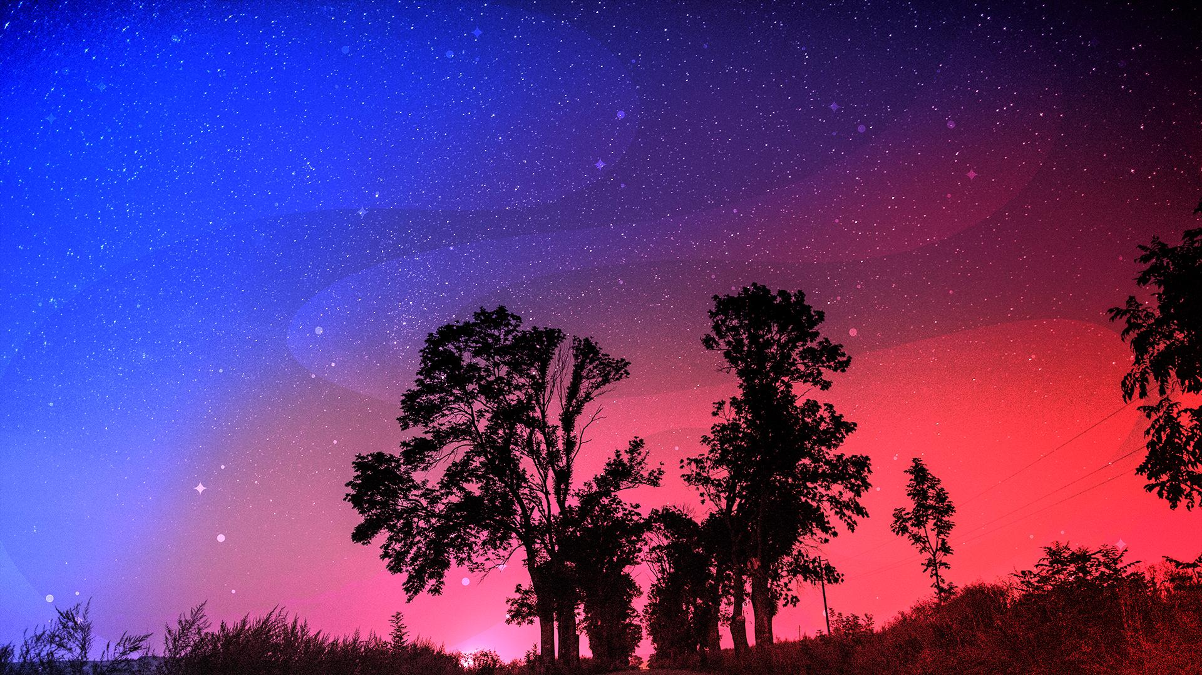
THERE IS AN EXOPLANET CALLED 55 CANCRI E MOST LIKELY MADE OF DIAMONDS.

Slide 24
HISTORICAL ASTRONOMICAL DISCOVERIES
Apollo 11/ The Soviets launch the first thing in space
Dark matter dark energy is discovered.
1957-1969
1993-1998
1532
1990-1997
Nicolaus Copernicus published a suggestion of the Sun being the center of our solar system.
The Hubble Telescope, and Voyager 1 and 2, are launched.

Slide 25
03
Nasa & the ISS
The National Aeronautics & Space Administration has been here for about 70 years. But, what is it?

Slide 26
What is Nasa?
Well, Nasa stands for the National Aeronautics & Space Administration. Basically it is a U.S government agency that is responsible for science and technology related to space/air. Nasa was created in 1958 and was created for to look over U.S space exploration & research. Now, it’s grown and expanded, working with global partners to create things such as the ISS and sending the first PERSON to the moon. But what were some of their missions?
One of the most recent missions Nasa has ever sent to another planet is the Perseverance rover. Part of NASA’s Perseverance Rover’s mission includes collecting rock samples from Mars that could later be retrieved and brought to Earth for study as part of the Mars Sample Return campaign. Scientists on the rover team want to make sure the most effective samples are chosen to accomplish two of the major goals of returned sample science—searching for signs of life and geologic history dating. Therefore, it is important for scientists to understand how these rock samples formed, and how they might have been altered over geologic time.

Slide 27
GLOBAL SPACE ORGANIZATIONS
(and their annual budgets)
NASA
ESA
ISRO
CNSA
RFSA
JAXA
$24 billion
$17.6 billion (over 3 years)
Rs.12,543.91cr
$8.9 million
$6.6 billion
155 billion yen

Slide 28
THE ISS
The ISS is the International Space Station which constantly orbits the Earth, making 16 orbits every day. The ISS was created as a global collateral so that humankind could explore and learn more about space. Experiments are done all the time, so you could say that the ISS is a laboratory in space. Astronauts live and work there. Using research and more, we can learn more about space and eventually learn how to explore other galaxies. Plus, astronauts living on the ISS can release and repair telescopes/satellites.
The ISS was actually built in space from various components. Astronauts would go up into space with a few components and fit pieces together like a puzzle piece.
The first part of the ISS was launched by Russia on November 20, 1998.
The first humans came to live there on November 2 2000.
On Earth, the space station would weigh almost a million pounds.
The station covers the football field, including the end zones.
It’s as big as a five bedroom house.
The ISS is basically a bridge for humanity. Not just a certain country or continent or hemisphere, everyone. All global space organizations work together to learn more about space for Earth.

Slide 29
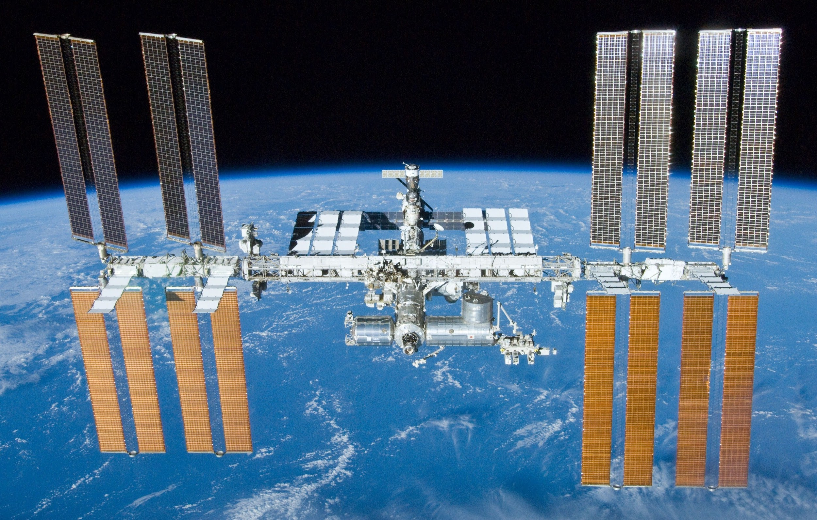
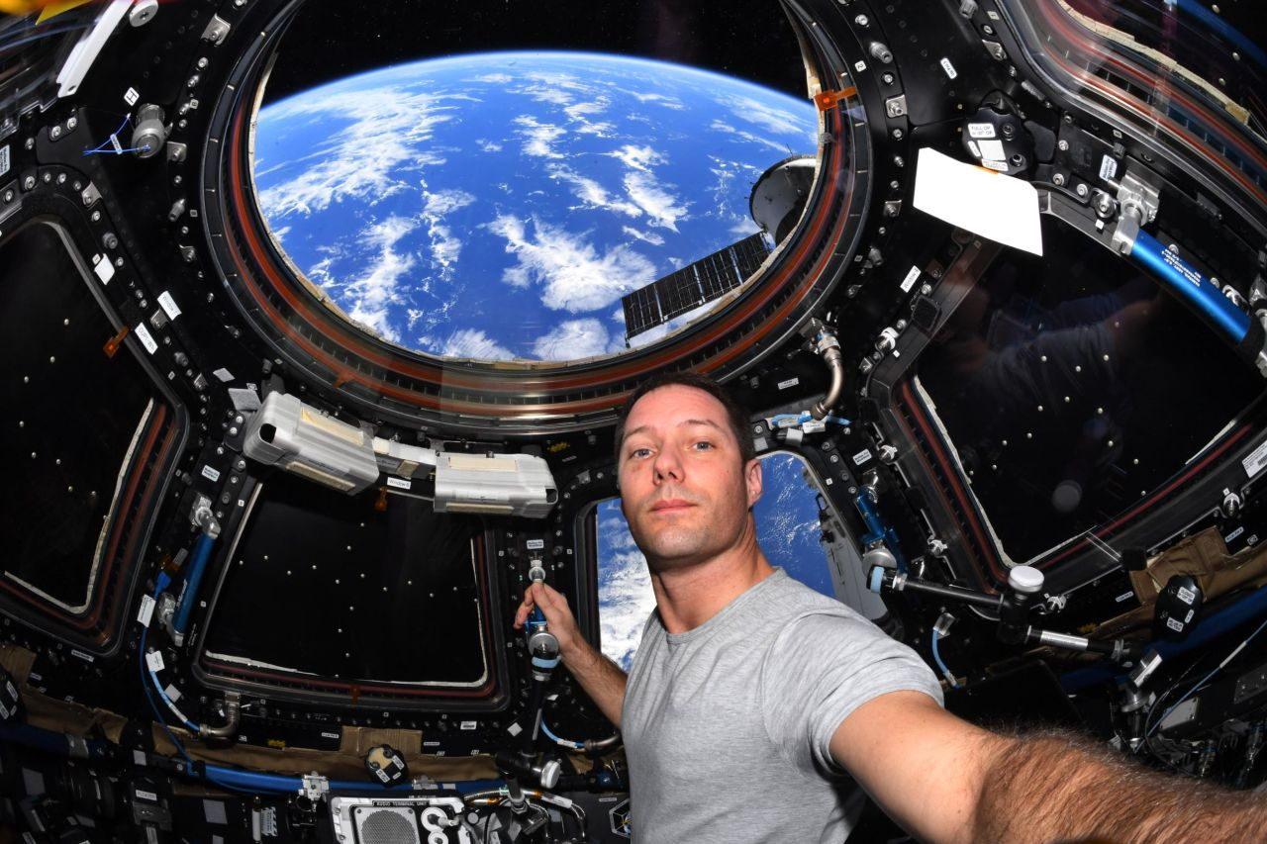
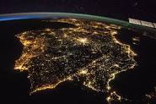
Just some pics…

Slide 30
04
THE THEORIES
Welcome to the world of theories!

Slide 31
THEORIES
Scientist say we know only 5% of the universe, the known and visible universe, but I believe it is much smaller. MUCH smaller. As the universe keeps expanding, so does our knowledge. For all we know, banana unicorns could be flying through space pooping starbeams and causing rainbows to appear. Or asteroids could be messengers from these very banana unicorns to talking water bottles and ketchup while flying turtles film them. Very unlikely, but that’s just us! Forced to create theories using proof , people have become immersed in the world of possibilities. So, here’s a little sneak peak of the wonderful world of theories.

Slide 32
THE THEORY WORLD
THE BIG BANG
RELATIVITY
Scientists are utterly convinced that once energy was forced into one, really tiny ball. When it couldn’t hold it anymore, it exploded spreading elements like hydrogen and helium and forming our worlds.
Albert Einstein revealed that objects that have lots of mass create holes in the fabric of the universe, the fabric of space and time. It has been tested a lot.

Slide 33
STARTLING FACTS
Dark Energy/Matter
THE MULTIVERSE
When scientist realized there was another invisible force causing the universe to expand, they called it dark energy. Dark matter is all the invisible stuff, most of the entire universe.
What if infinite universes co-existed? Multiple versions of ourselves could be possible, for the better and worse. Wiki says,”The multiverse is the hypothetical set of all universes. Together, these universes are presumed to comprise everything that exists: the entirety of space, time, matter, energy, information, and the physical laws and constants that describe them.

Slide 34
BLACK HOLES or WORMHOLES?
WHAT ARE THEY?
Black holes are invisible cores of dead stars. After giants die, their cores become a region of space with so much gravity that not even light can escape, so it’s invisible. The more smaller a black hole is, the more gravitational pull it is. The event horizon is where nothing can escape a black hole, and no one knows what happens when you do. Some people believe you get stretched out like spaghetti till you die. Real smooth.
WORMHOLES
A ton of people believe that a black hole is a hole in the space/time fabric which allows us to travel to a different place in time and time. So, basically, black holes might be shortcuts through the world. Just like the Point A/B theory. And, we could travel through time and maybe other dimensions, which we’d misuse. But, black holes can kill us very easily. So, we don’t have enough proof of this. Plus, we can’t sent a probe into black holes because black holes suck light, and we wouldn’t see anything.

Slide 35
05
Cool Facts
Yeah, sure, this isn’t on the table of contents. But there’s a whole universe out there, so here’s a part of it.

Slide 36
HOW ABOUT THE PERCENTAGES?
99.86%
95%
68%
27%
of the solar system’s mass is the Sun.
of the universe is invisible, taken up by dark energy/matter.
Of the universe is dark energy.
Of the universe is dark energy.

Slide 37
0.0035%
Of the Electromagnetic Spectrum (all light) is visible to us humans.

Slide 38
The Electromagnetic Spectrum (and philosophical thinking)
When light is emitted, they come in different wavelengths, or frequencies, which then becomes reflected light. Reflected light becomes color, like red and blue. All of these frequencies, wavelengths, light, and colors are part of the Electromagnetic Spectrum, which is all light. But, we can’t see much of the spectrum. In fact only 0.0035% of all light is visible by humans. So yes, even in a pitch black room, the room is flooded with light we just don’t understand.
Humans have a certain way of thinking. Our brains are wired a certain way that we can’t comprehend other things. In fact, many civilizations would have already tried to communicate with us and we just couldn’t understand it. As Stuart GIbbs said, it would be like ants trying to understand what a rocket ship is. Concepts like music, art, and literature might be new and completely understandable to other creatures, but they might also have concepts we can’t. We also have limited senses and the senses we do have are limited. Whatever humans know right now will change. Some things are brains just can’t push into our system and understand, so our society evolved in a certain way around the things we “know”.
Not a theory.

Slide 39
ASTEROIDS VS. METEORS
ASTEROIDS
NASA’s short description is,”Asteroids are small, rocky planets that orbit the Sun.”. Hanging around the asteroid belt, between Mars and Jupiter, they come in all shapes and sizes. Usually rocky and shaped like weird things, they’re made of different kinds of rocks, but also metals like iron and nickel. When our solar system formed and dust came in the center/formed into planets, there were some leftovers, forming into asteroids. By studying these, we can understand more about the formation of our world.
METEORS
According to National Geographic, meteors are light streaks in the sky caused by meteoroids, which are lumps of iron and rock, orbiting the sun, and most likely fragments of rock caused by asteroid explosions and comet debris. When meteoroids fall into Earth’s atmosphere, it burns up, due to the high friction and gases appear to create a halo, or a streak of light, and are now called meteors. Meteors usually burn up before they hit the ground, but the few ones that do are called meteorites. Meteor showers are a breath-raking phenomenon globally.

Slide 40
Asteroids, Meteors, and Comets!
Comets
Chiron
Asteroids
Are dirty balls of frozen gases and rock, and form a “tail”.
Looks like an asteroid, but it grew brighter near the sun; a comet.
Have water; the theory is that Earth got water from an asteroid.

Slide 41
“That’s one small step for a human, one giant leap for humankind.”
Neil Armstrong-
(Edited by MV & TB)

